Slide 1
Human Rights Film Festivals as Educational Platforms
KUTSENKO ELENA
regional coordinator of Travelling Human Rights Film Festival DOCUDAYS UA

Slide 2
DOCUDAYS IN CRIMEA
since 2006
in educational institutions, libraries, cultural institutions, cinemas, etc.
7 towns and 9 rural regions
2013 – 5 090 viewers; 2014 – 3734
15 film clubs in schools

Slide 3
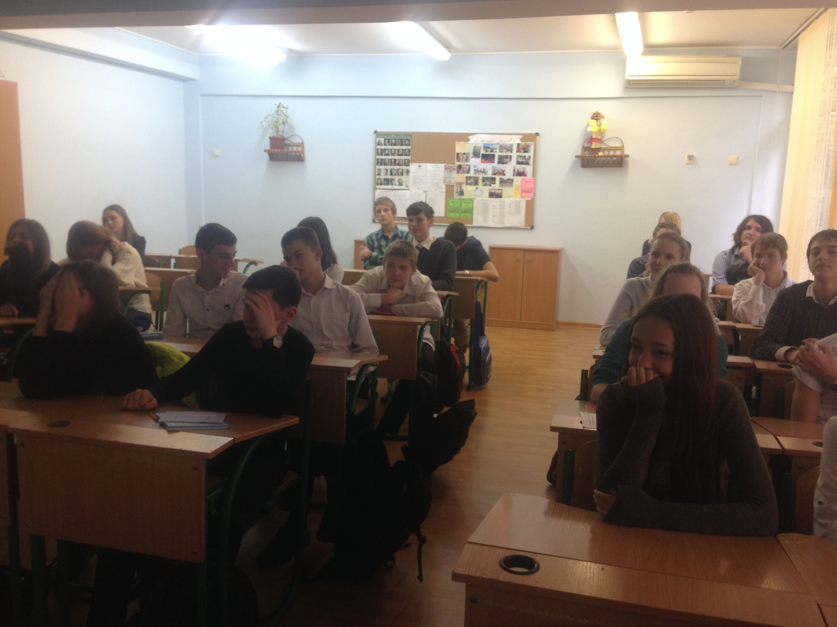
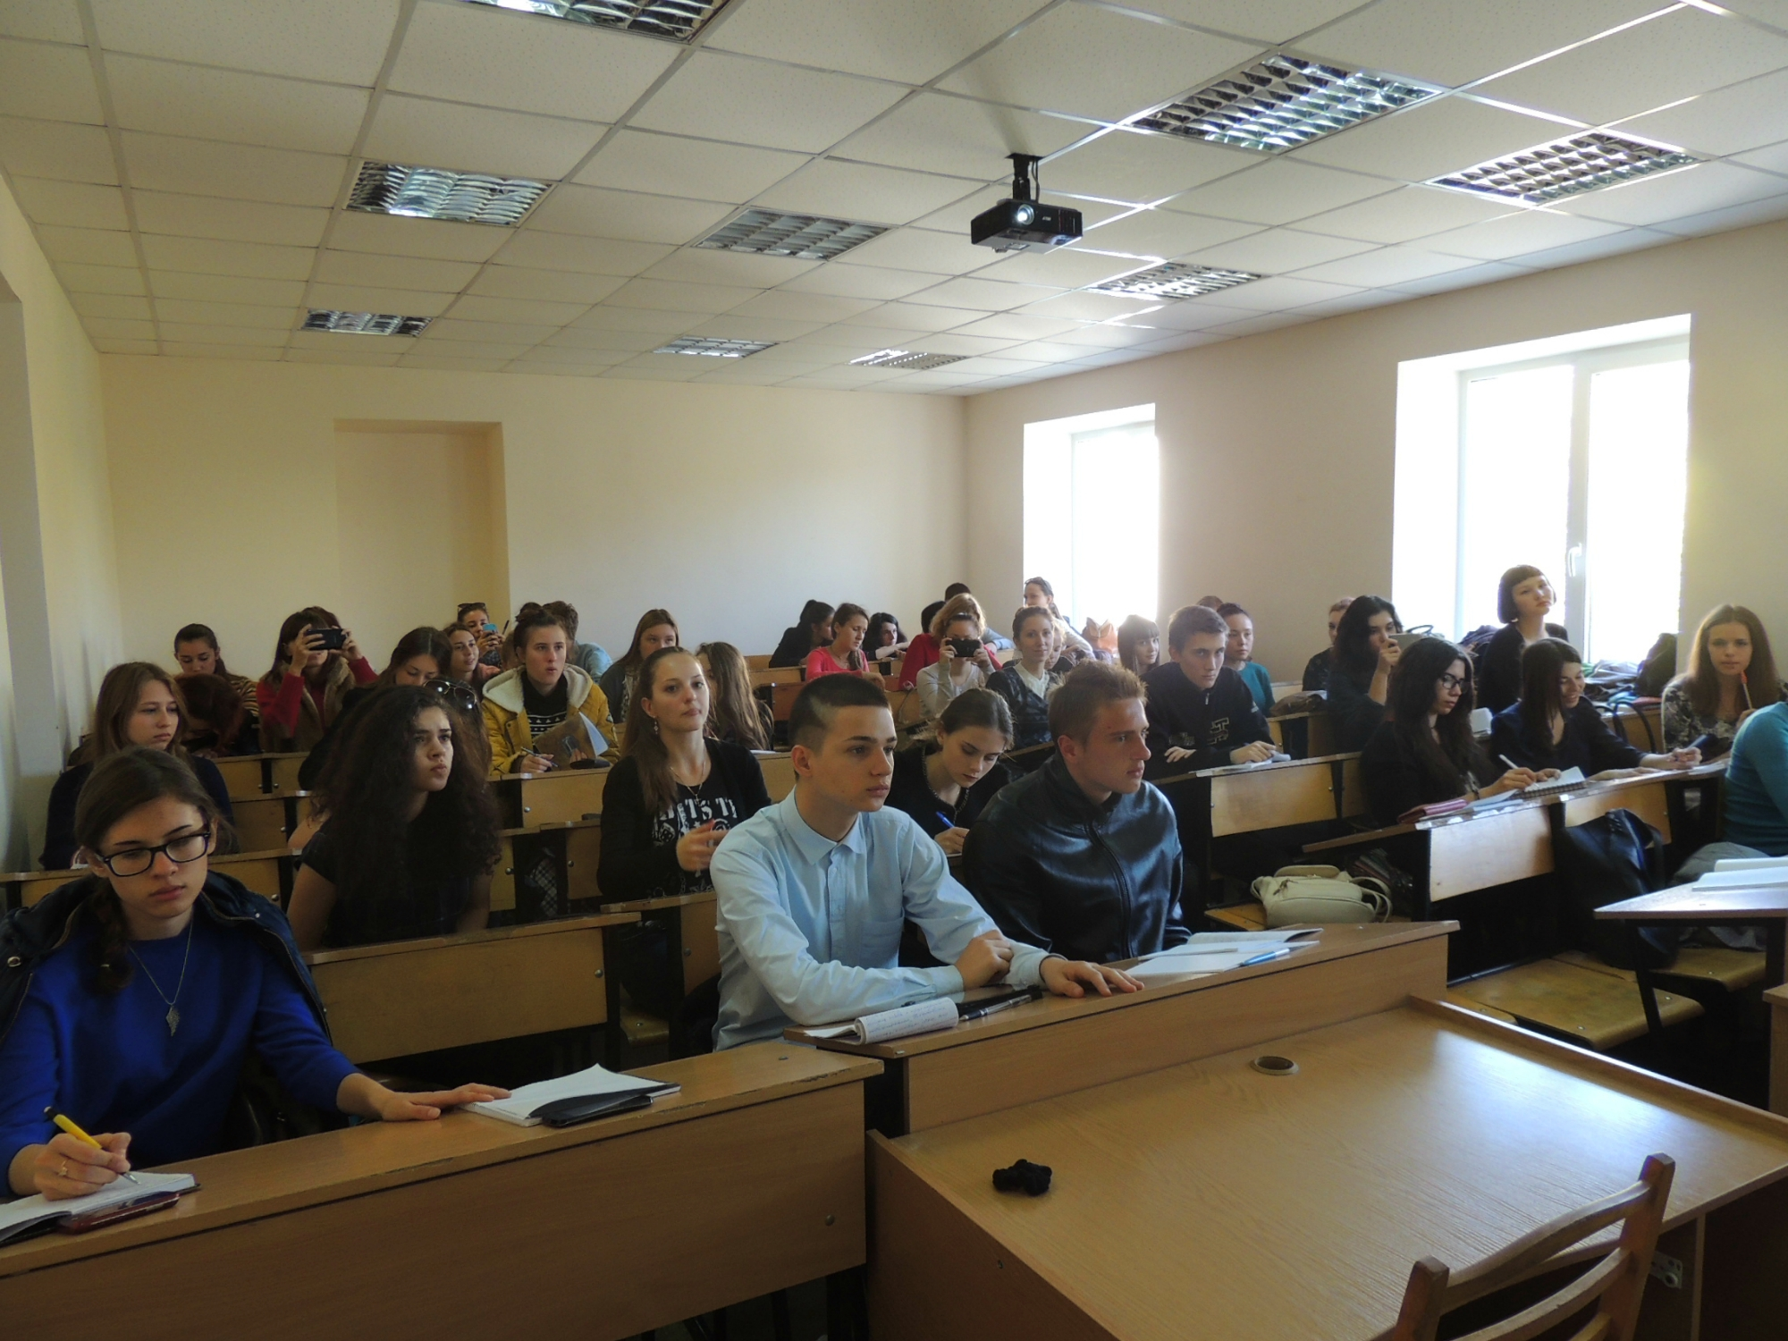
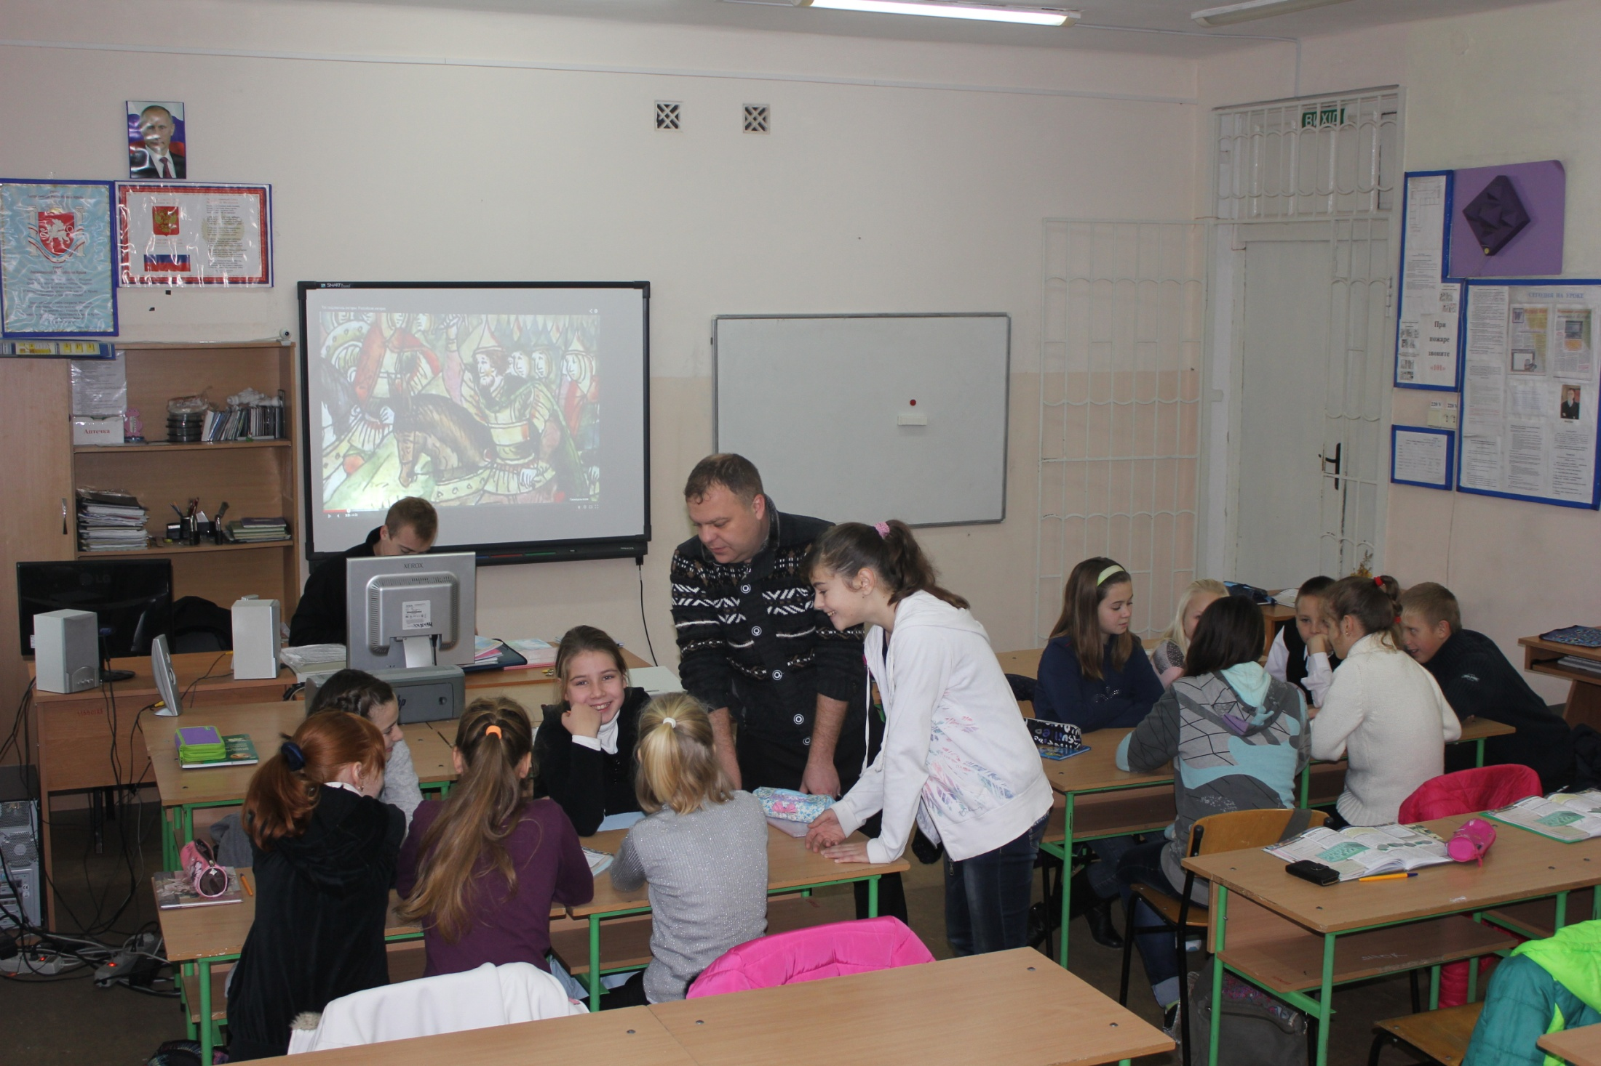
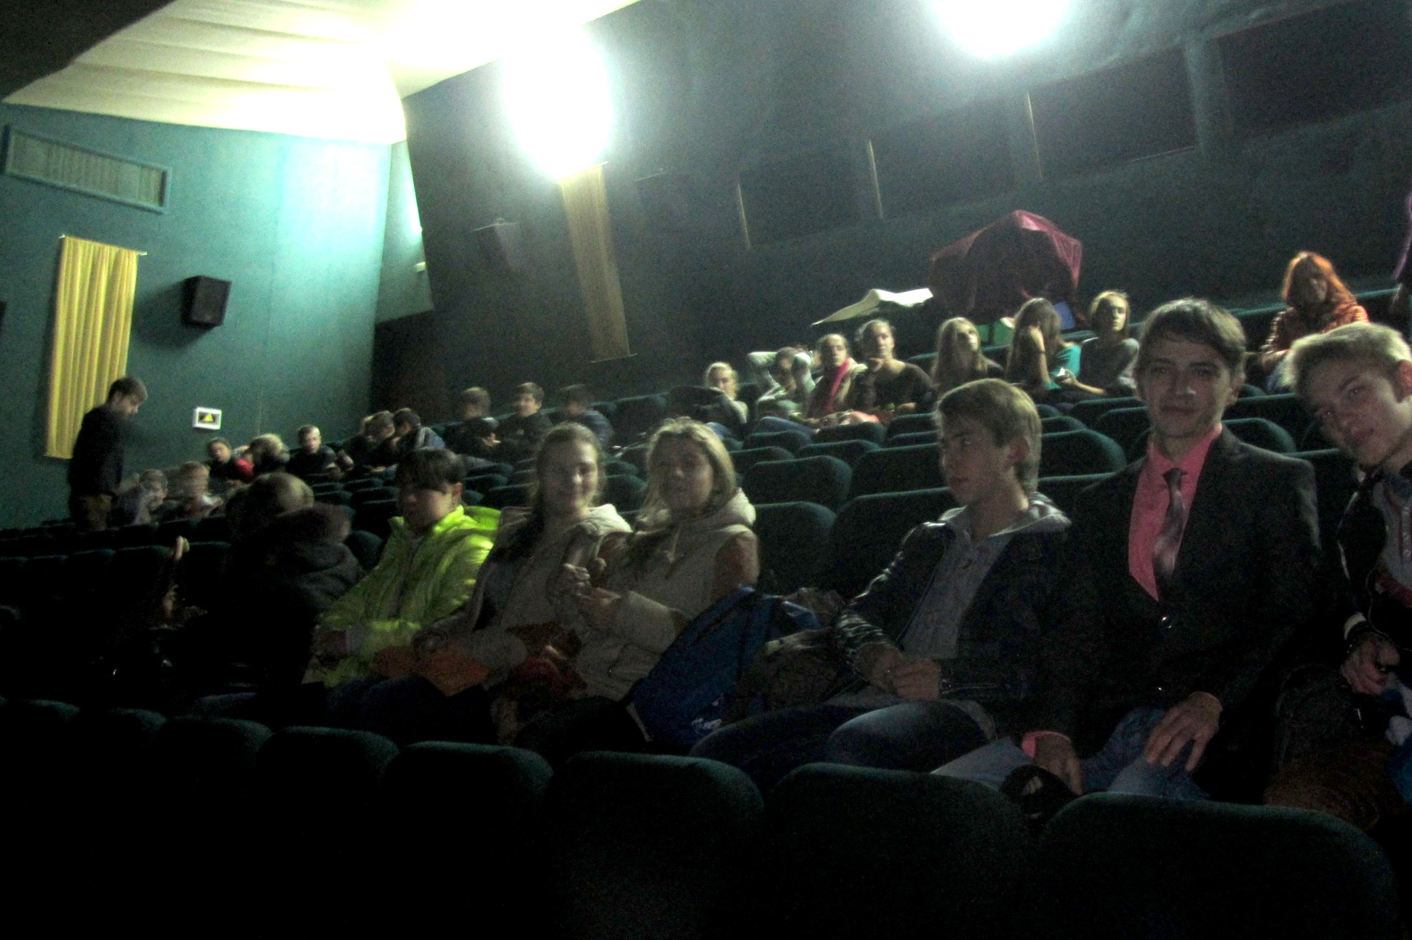
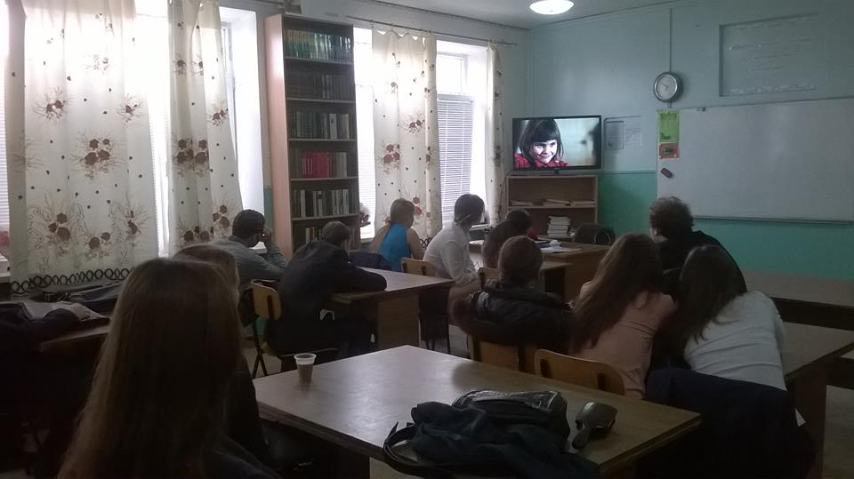
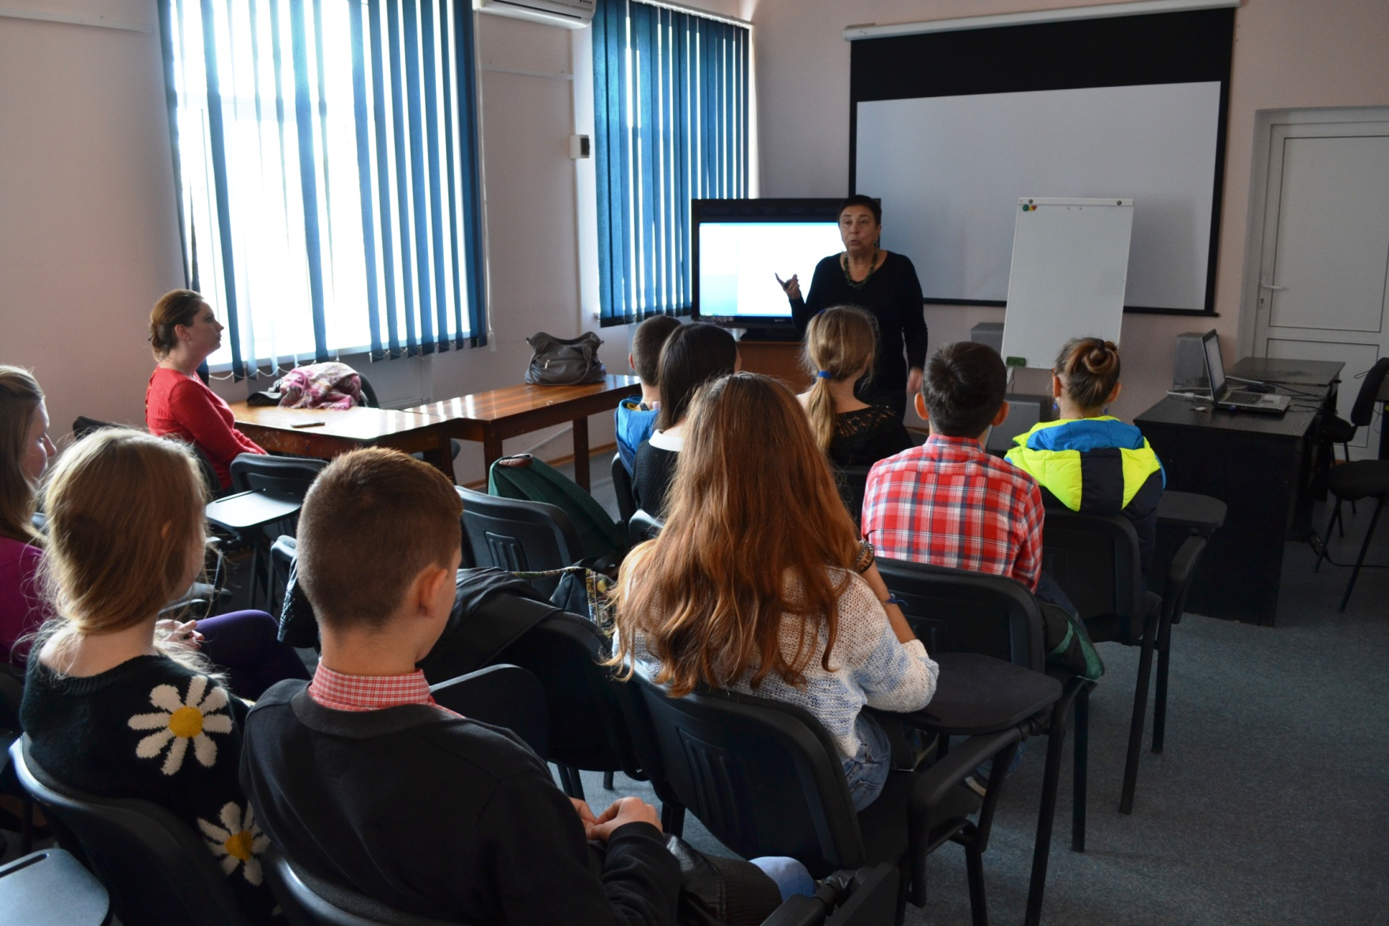

Slide 4
PROJECT
Campaign for Fundamental Rights in Ukraine through Instruments of the International Human Rights Documentary Festival Docudays UA

Slide 5
AIMS
open film clubs on human rights in schools, universities, institutions, libraries,
create film collection (30) and study guide for teachers and film club moderators.
film clubs stuff (leaders, moderators) training

Slide 6
WHAT IS DONE
a number of trainings for film clubs moderators;
2 film collections – each of 10 films from DOCUDAYS festivals of former years;
e-manual for teachers and moderators with chapters: “How to open a film club”, “How to watch the film”, “Film discussing methods”, “Experience of our colleagues”

Slide 7
work in semantic groups;
hot microphone;
pivot words;
prognostic;
film director’s notebook;
Tabula rasa;
contrasts in film studing;
bank of ideas;
me and my film character;
letter to film director.

